Slide 1
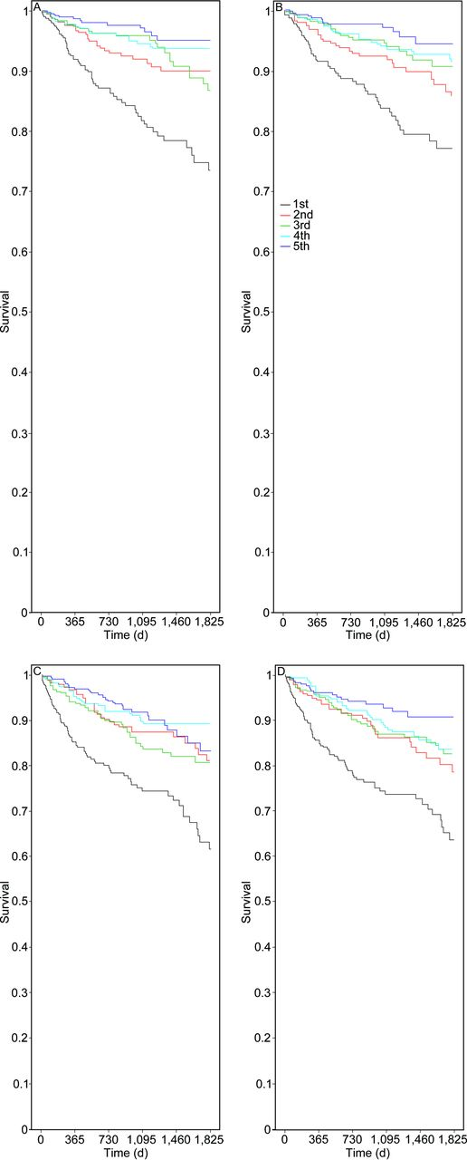

Kaplan-Meier survival curves for the association of quintiles of FVC (A, C) and FEV1 (B, D) with mortality among females (A, B) and males (C, D), with all P values having P trend < .001.
Benjamin D Horne et al. Respir Care 2015;60:1314-1323
(c) 2012 by Daedalus Enterprises, Inc.
Notes:
Kaplan-Meier survival curves for the association of quintiles of FVC (A, C) and FEV₁ (B, D) with mortality among females (A, B) and males (C, D), with all P values having P trend < .001.

