Slide 1
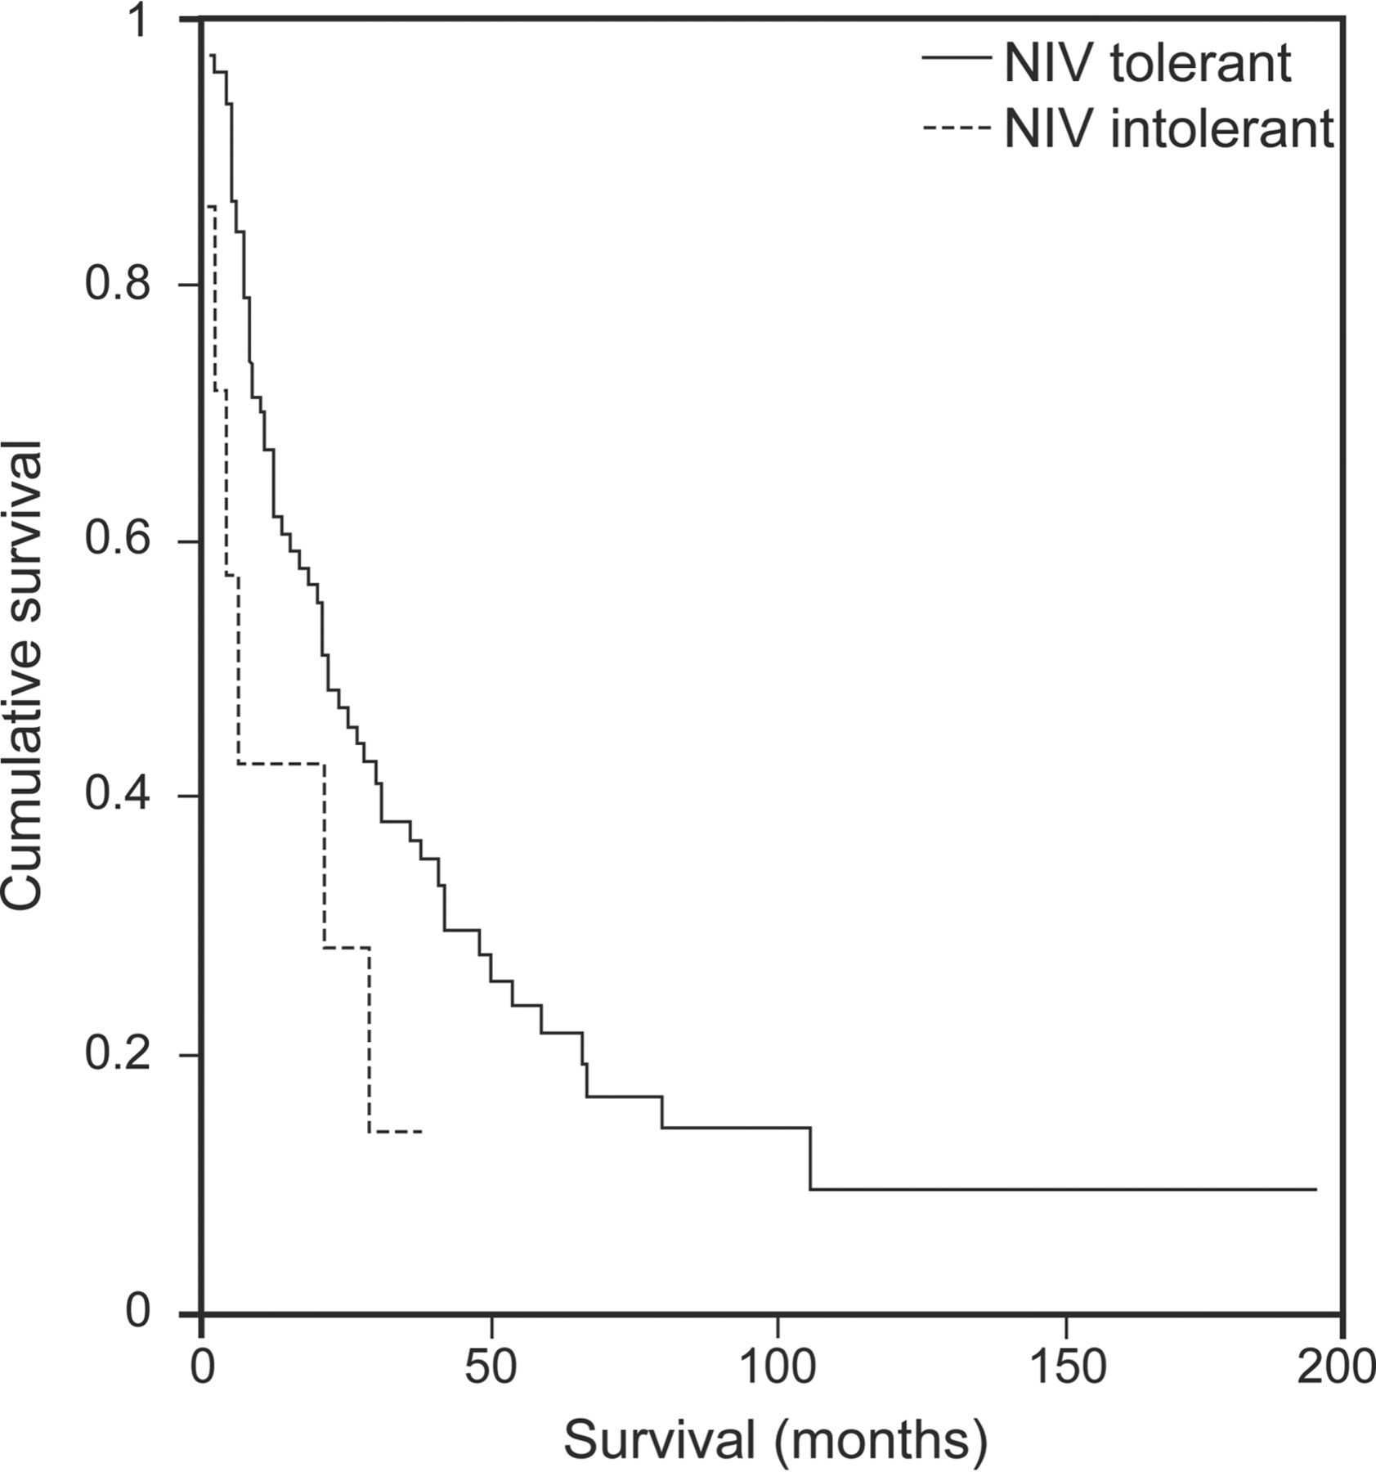

Survival without tracheostomy from initiation of noninvasive ventilation (NIV).
Daniel Martínez et al. Respir Care 2015;60:1765-1771
(c) 2012 by Daedalus Enterprises, Inc.
Notes:
Survival without tracheostomy from initiation of noninvasive ventilation (NIV).

