Slide 1
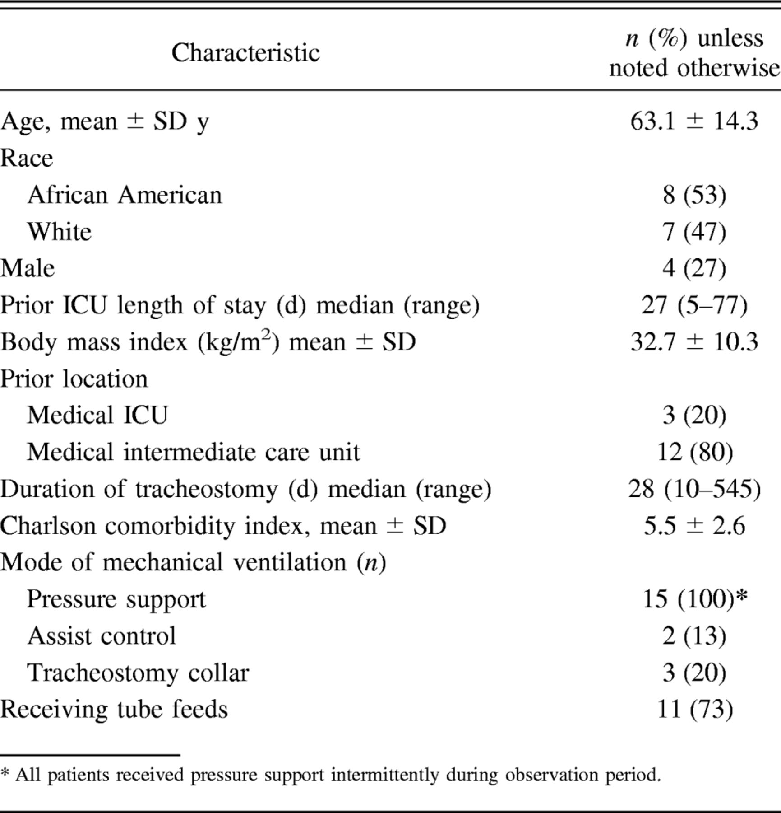

Demographics and Characteristics of 15 Patients Admitted for Weaning From Prolonged Mechanical Ventilation.
Dafna Koldobskiy et al. Respir Care 2014;59:518-524
(c) 2012 by Daedalus Enterprises, Inc.
Notes:
Demographics and Characteristics of 15 Patients Admitted for Weaning From Prolonged Mechanical Ventilation

